Slide 1
우주궤도역학 Term Project #2
19011240 김재휘

Slide 2
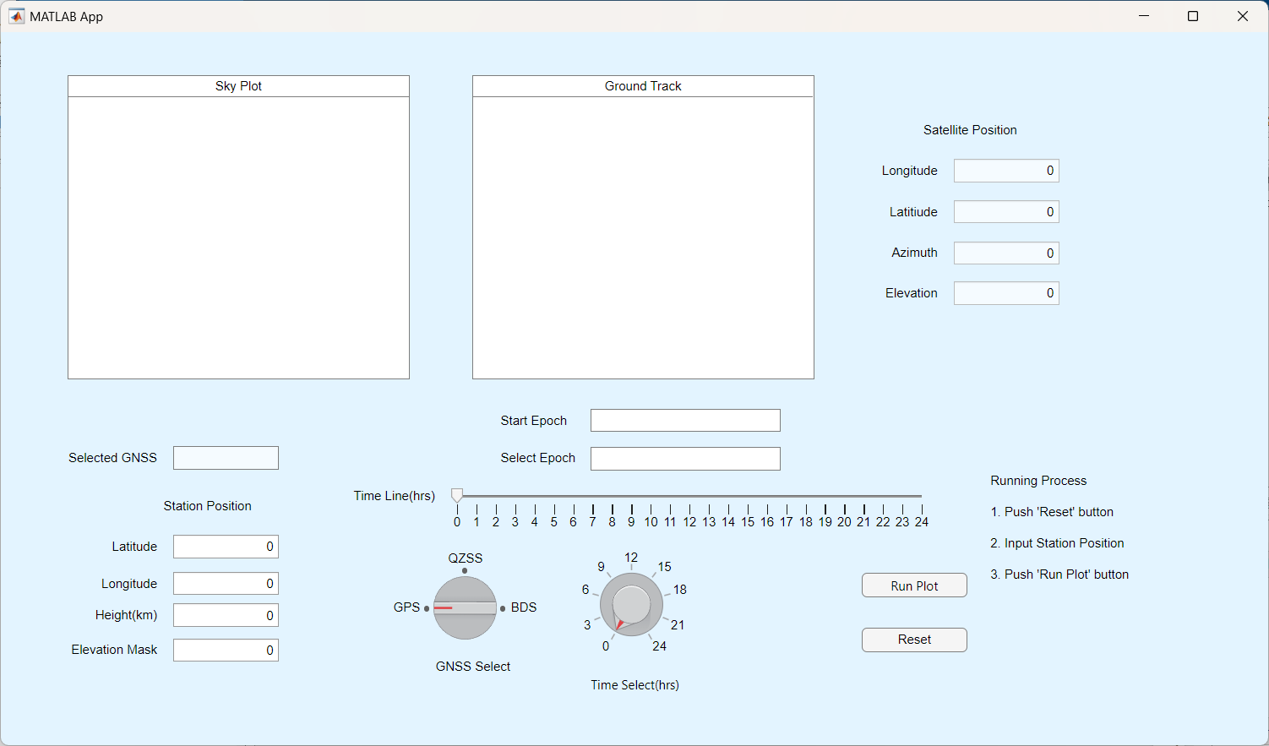
App 구성요소 설명
3
Sky Plot Panel
Ground Track Panel
Satellite Position
Station Position(Editable)
GNSS Select Knob
Epoch Select Knob
Epoch Select Slider
Plot Running Button
Reset Button
1
2
7
4
8
5
6
9

Slide 3
App 작동 알고리즘
Skyplot Panel
Ground Track Panel
Satellite Position
Orbit Scenario
Reset Button
Plot Run Button
sat_pos.m
Station Position
GNSS Select Knob
Epoch Select Knob
Epoch Select Slider

Slide 4
Orbit Value 계산 알고리즘
nav.mat
solveRangeInPerifocalFrame
PQW2ECI
ECI2ECEF_DCM
Orbit Parameters
azimuth
elevation
Term_Project_2.mlapp
ECEF2ENU
latitude
longitude

